Slide 1

JIP33 Public Review Townhall
FLARE PACKAGES (API 537)
Mark Davies - Project Engineer
Technical Consultant (external) working on behalf of IOGP
June 2026

Slide 2
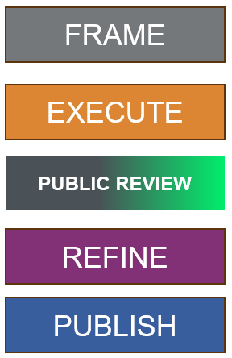
Objectives of the meeting and agenda
RECORDING
Townhall will be recorded to support you in efficiently completing the public review.
01
Opening and Introduction (5 min)
The JIP33 specification update is to frame the scope and requirements needed to execute the update of the specification to be fully developed prior to public review process.
Followed by reviewing and refining the specification for publication for maximum adoption within the petroleum and natural gas industries. .
The project group / IOGP Competition law
02
JIP33 background (10 min)
Specification update process
03
Purpose of the Public Review (15 min)
IOGP S-722 overview, what is expected from reviewers, post public review
04
Demonstration of a review in Jama (20 min)
Way forward
05
Recap, questions (5 min)
2
Notes:
If you can refrain from asking questions during the presentation, I will hopefully address them further in the PowerPoint. We should have time at the end for Q&A. / Put any questions into the chat.

Slide 3

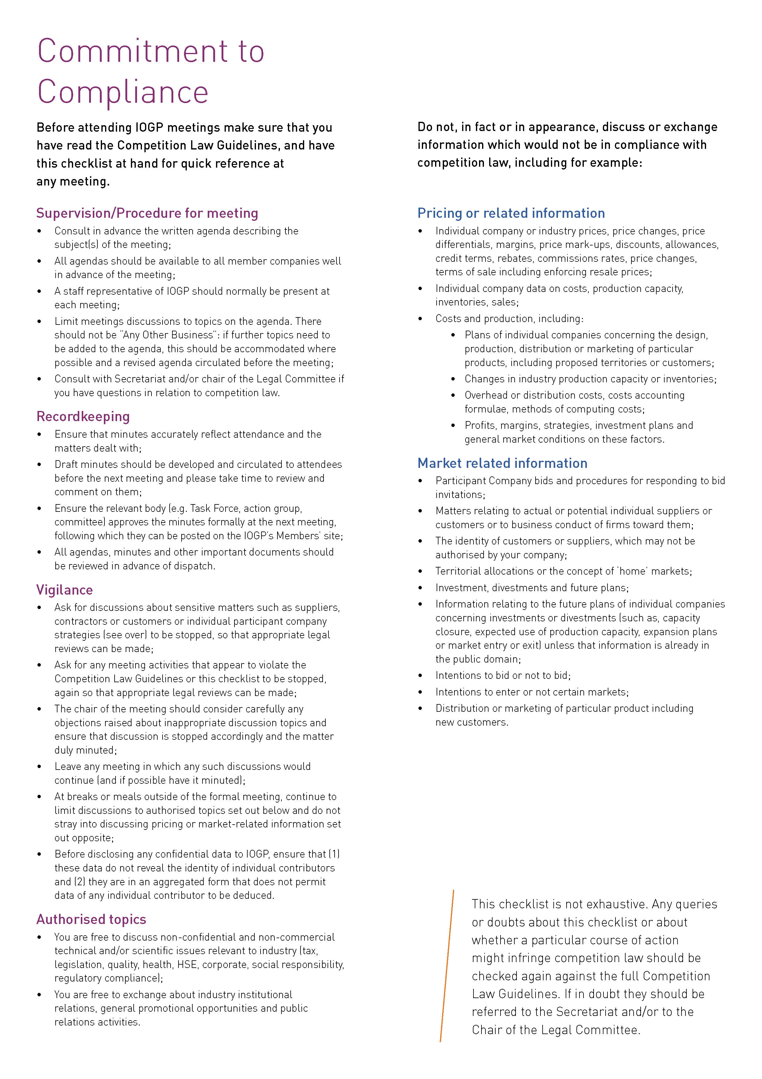
IOGP Competition Law policies
It is the policy of IOGP to comply with all governmental laws, rules, and regulations applicable to its operations and to conduct those operations to the highest ethical standards
Accordingly, directors, officers, and employees of IOGP are advised to consult with the Senior Legal Manager for advice on applicable United Kingdom laws and are expected to comply with those laws
No one has authority to give any order or direction that would result in a violation of this policy
Importance of management
leadership and accountability
Please read the key elements of
IOGP’s Commitment to Compliance
on Sharepoint:
Object to discussion about
inappropriate topics
Why is Competition Law important to me?
IOGP is required to comply with all laws applicable to its business
Penalties may be levied against IOGP or individual employees
IOGP is liable for violations even if business lines or individual employees are unaware of or do not intend to violate the law
UK competition law is complex and changes frequently

Slide 4
S-722 Workgroup participants
Abdulaziz H. AL-Tijani | Aramco
Johan Liekens | bp
You Lixin | Chevron
Pete Slater | ConocoPhillips
David Gudgeon | ENI
Øystein Larsen | Equinor
Sultan Ahamad / Eric M Barta | ExxonMobil
Gustavo Schiavone | Petrobras
Zulfadhli B Mokhti | Petronas
Adrian Valenzuela | Shell
Antonio Navas / Sarah Juma | TotalEnergies
George Tetlow | Woodside

Slide 5
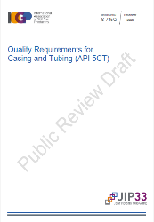
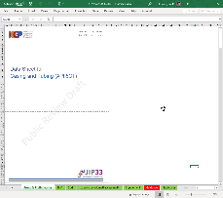

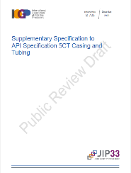
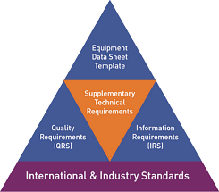
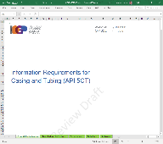

How it Works
JIP33 procurement specifications DO NOT replace or conflict with industry standards.
JIP33 procurement specifications DO AIM to replace the existing operator specifications with a single specification.
JIP33 procurement specifications DO AIM to influence the supply chain by
  standardizing the requirements for HV induction motors among all 12 oil and gas operators.
  by providing the specifications developed by all 12 oil and gas operator’s subject matter experts for FREE (benefitting other operators, the wider industry, suppliers and EPCs) .

Slide 6
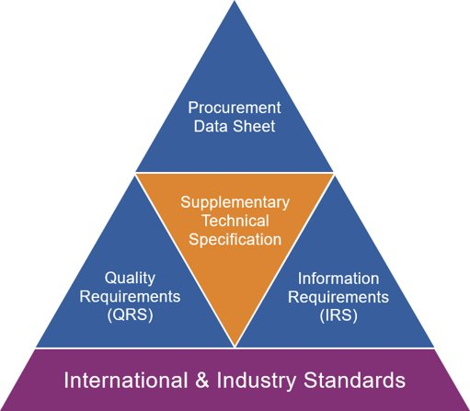
JIP33 - overview
JIP33 specification package
IOGP S-704 & IOGP S-722J *
A Supplementary Technical Specification (TRS) to an industry standard or a Standalone Specification, comprising a set of “minimum requirements” sufficient to purchase equipment that meet the operators’ functional needs.
IOGP S-722D
A Procurement Data Sheet (PDS) for specifying the options the purchaser wishes to select for project specific requirements and information.
IOGP S-722L
An Information Requirements Specification (IRS) providing a list of
pre-defined documents and data required to be delivered by the supplier.
IOGP S-722Q
A Quality Requirements Specification (QRS) specifying the quality management system, inspection and testing activities.
* J denotes technical specification with justifications.

Slide 7
Where we are now..
Specifications are regularly reviewed by JIP33 working groups to ensure they remain up to date and aligned with underlying industry standards.
FRAME
EXECUTE
PUBLIC REVIEW
REFINE
PUBLISH
4 weeks
~ 10 weeks
Users, suppliers, EPCs and SDOs can participate and comment via the initial User Survey. (Maintenance only)
Users, suppliers, EPCs and SDOs can participate and comment via the Public Review.
The suite of IOGP documents have been digitized in JAMA to current JIP33 quality levels.
Justifications, coverage and links between requirements have been created.
Reviewed and amended in line with the current JIP33 drafting principles and rules.

Slide 8
Public review
Specification developed by a small core team of operator SMEs.
Public review automatically includes twelve JIP33 participant operators.
Public review provides platform for input from other operators, suppliers, EPCs, SDOs, etc.
Therefore, we need input from the wider industry to add value.

Slide 9
S-722 Maintenance
The suite of IOGP documents have been digitized in JAMA. Justified & verified with coverage.
The specification requirements have been reviewed and amended in line with the updated IOGP writing requirements. Specification requirements have been deleted where they did not follow the IOGP standard for requirements writing.
Where the parent standard makes a statement which we agree with, there is no need to reiterate in our specification.
Where a subject has been addressed in the data sheet, we do not reiterate in the technical requirements.
Essential content must be considered every step of the way.
Parent standard changes and comments from user review incorporated where appropriate.
The 80/20 rule applied to ensure a streamlined specification is achieved.

Slide 10
IOGP S-722 Jama vs Document
Why does the data in Jama look different to the document?
Digitization of API Standard 537 4th Edition 2024, addendum 2025.
One requirement, one unique item.
Avoidance of copyright infringement.
Why is everything included?
In case you need to leave a comment against requirements in the “parent standard” that are unmodified by this project.

Slide 11
S-722 numbers due to update (maintenance)
TRS | First edition | Public Review | Observations
No of pages | 20 | 55 | Now with justifications
No of requirements | 153 | 169 | 100+ Overlays, 50 implemented. 4.5 winterization
PDS
No of requirements | 743 | 720 | Multiple tabs, Case X process design conditions
IRS
No of requirements | 102 | 102 | Aligns with JIP33 best practices,includes CFIHOS codes
QRS
No of requirements | 33 | 26 | Aligns with JIP33 best practices

Slide 12
IOGP S-722 – overview by SME
Johan
Antonio
S-722 is an overlay to 4th edition of API Standard 537 published in 2024, addendum 1, Jan 2025.
  S-722 first edition was based on API537 Third edition (March 2017)
  Current Peer review looks at S-722 as an overlay to API STD 537 4th edition, incl. Addendum 1.
Overlay reconciliation.
Generic topics:
  Winterization
  Flare pilots/flare ignition
  Labyrinth Gas Seals
  Ballistic ignition systems in offshore applications
e
z.

Slide 13
What is expected from the reviewers?
Review of all documents in conjunction with each other - JIP33-MAN-WI-02.
Documentation and inspection & testing requirements incur significant costs, reviewing the IRS & QRS is as important as reviewing the specification and procurement data sheet.
Involvement of other stakeholders within your organizations. Aim to consolidate.
Comments to be clear and concise – and to include proposals and justifications.
Review of existing comments, using “reply” to add a comment or "thumbs up" to agree.
Identify specification requirements that are significant contributors to cost and schedule.
Identification of any “bespoke” requirements.
No overlays

Slide 14

Reviewing in Jama - Do
You will be adding your comments to a “public” review whereby all participants invited to comment are able to view and respond to each other's comments, including the operating companies that are contributing to JIP33.
For your comment to be addressed, it must have a rationale, ideally with a proposal.
Please comment against the correct and relevant item in Jama.
Do comment on items we may have missed – which can give an opportunity.

Slide 15
Reviewing in Jama – Do not
Comments which are in breach of IOGP's Competition Law Guidelines will be removed.
A comment that is standalone: “this is over specified” = shall not be reviewed, as it doesn’t have a justification/proposal against it.
Try not to ask questions in your comment – please help to resolve!
Avoid commenting on folders, sets and components which have a requirement ID containing “FLD”, “SET” and “CMP” respectively (e.g. ID: "S704-FLD-123”).

Slide 16
Reviewing in Jama - issues
Issues or “Red flags” should only be applied in the following circumstances:
• For operators, where a requirement may risk an organization’s adoption of the specification
• For suppliers and EPCs, where:
A requirement is adding excessive cost (or adding no value for the cost); or
If a requirement is impossible to meet or requires a proprietary solution.

Slide 17
Post-public review
What happens after I’ve submitted my comments?
Core team handling of categorized comments and updates to the specification.
1:1 calls can be available at the end of the review with suppliers.
Full work group review and alignment workshop of the amendments.
JIP33 governance group approval of the specification for publication.
Publication.
Based on lessons learned, we will conduct a “post-publication town hall” for feeding back to you all at a high level.

Slide 18

Demonstration and questions
Dates TBC
Demonstration of a review in Jama.
Must have a Jama account
  firstname.secondname
JIP33 Specification | start | end
S-722 Flare packages | 03 June 2026 | 01 July 2026
To be updated

Slide 19
Finally
Thank you for your continued support
We address all your comments – nothing is ignored.
Reviews coming up in 2026 Q3/Q4
  S-732 LV MCC (UL 845)
  S-742 MV MCC (UL 347)
  S-617 Cranes (EN)
  S-716 Tubing and fittings
  New specifications kicking-off in 2026
  S-703/704 LV/HV Induction motors (IEC) + S-745 HV Synchronous machines

Slide 20
Mark Davies – Project Engineer
Technical Consultant (external) working on behalf of IOGP
md@haar.uk

Slide 21
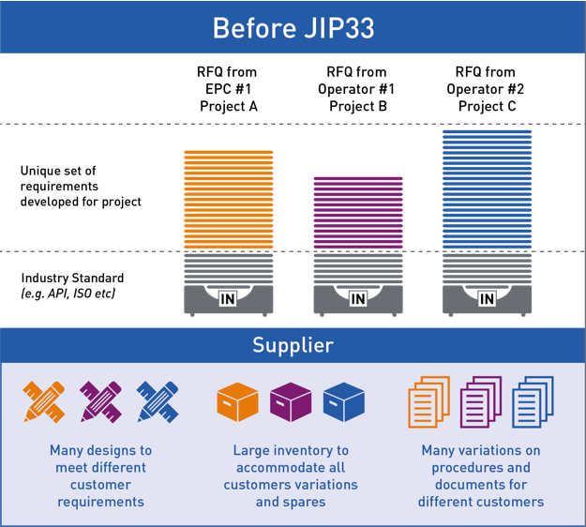
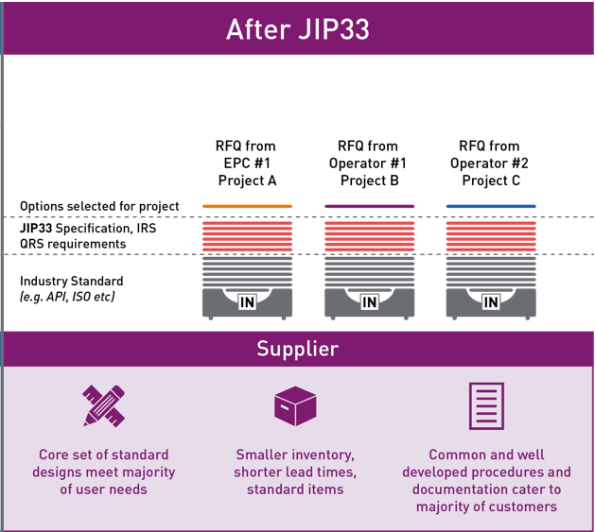
JIP33 - overview
Suppliers perspective

